Slide 1
DESIGN OF A 4:1 MULTIPLEXER AND EXTENSION TO AN 8:1 MULTIPLEXER
Subject: DDCA (Digital Design and Computer Architecture)
Project : Logic Gates, Digital Logic Diagrams and Logisim Implementation
Group Number:11
Group Members:
1. 2620030707 – BHANU SINGH
2. 2620030676 – VARA PRASAD
3. 2620090099 – DARSHAN
4. 2620090001 – SAHASRA
5. 262009011 – AKSHAYA MARRI

Slide 2
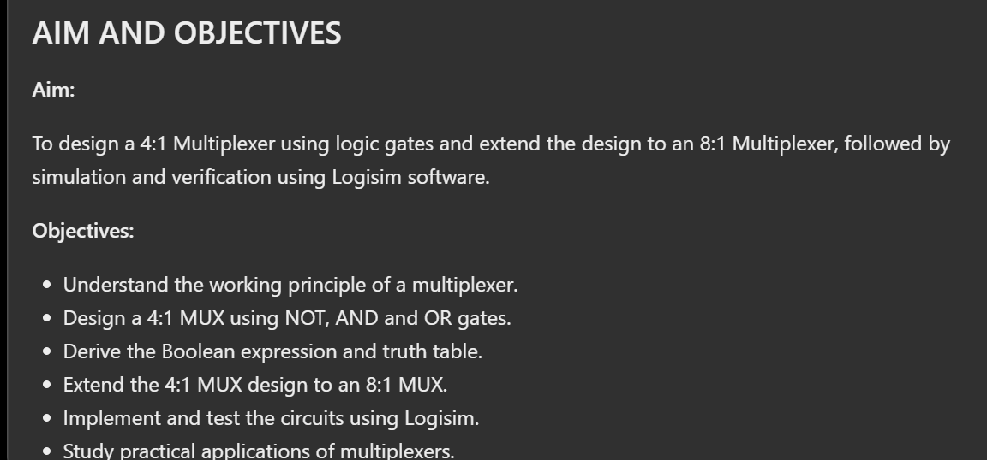

Slide 3
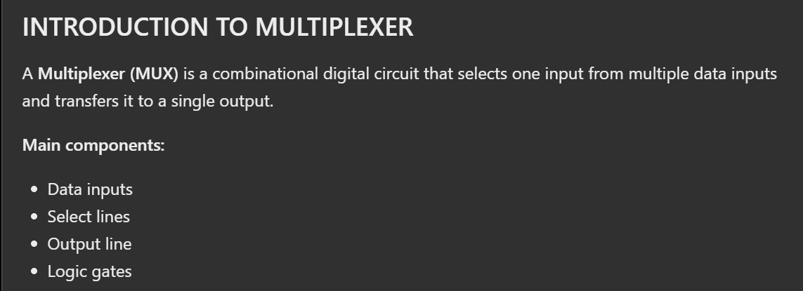
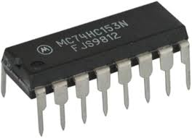
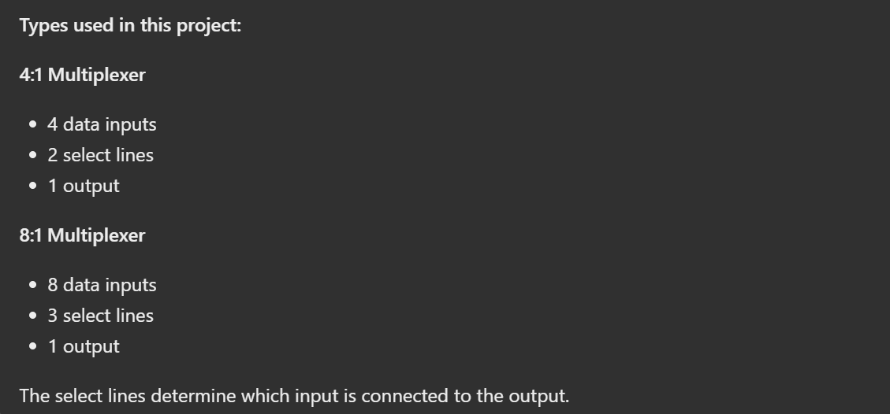

Slide 4
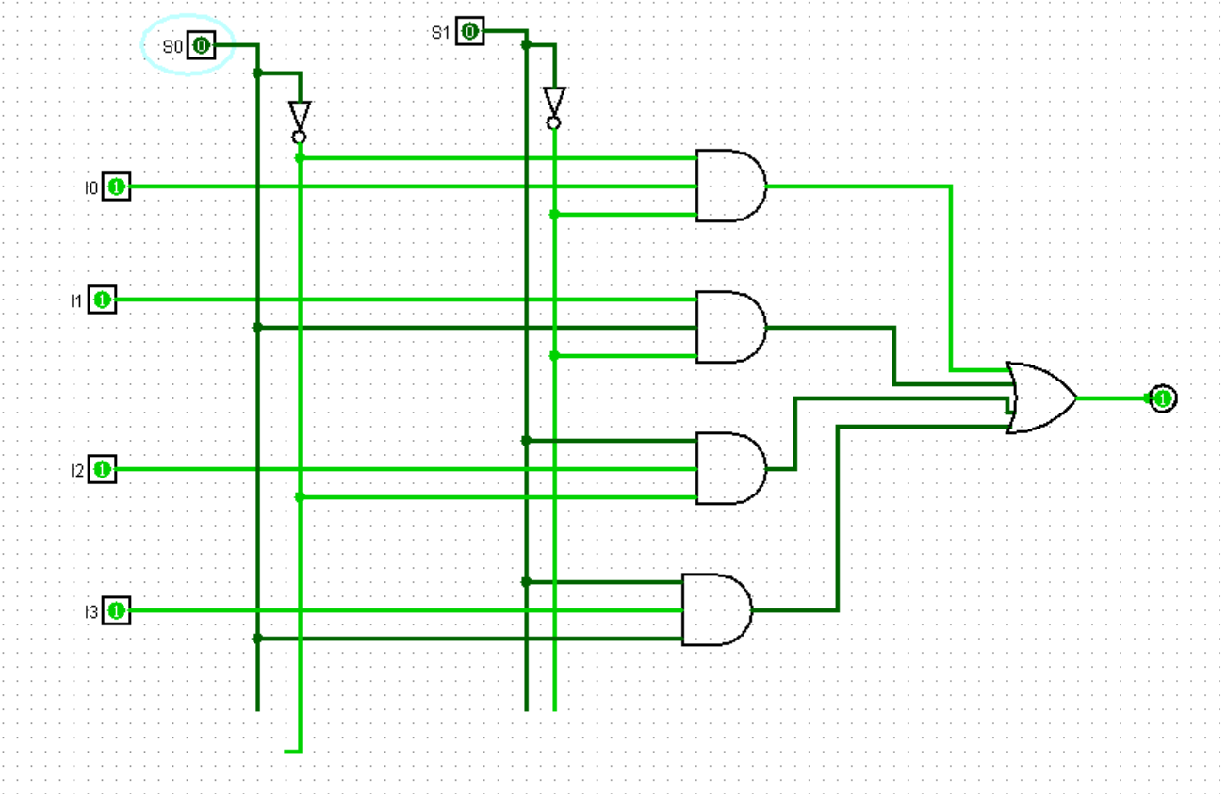
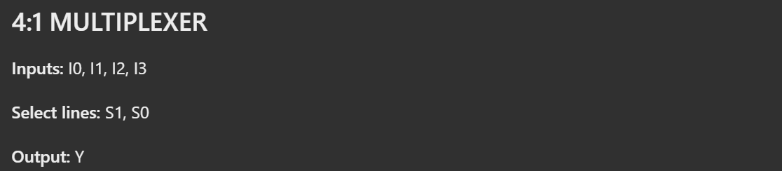
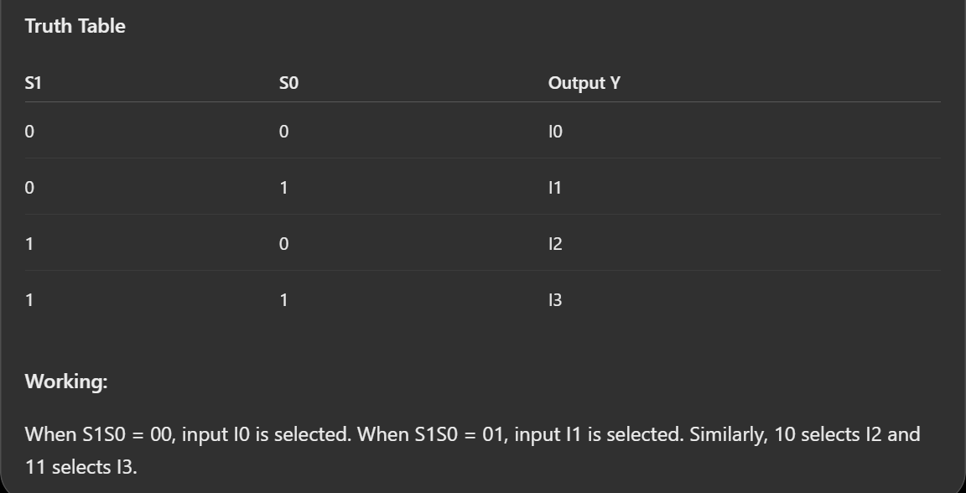

Slide 5
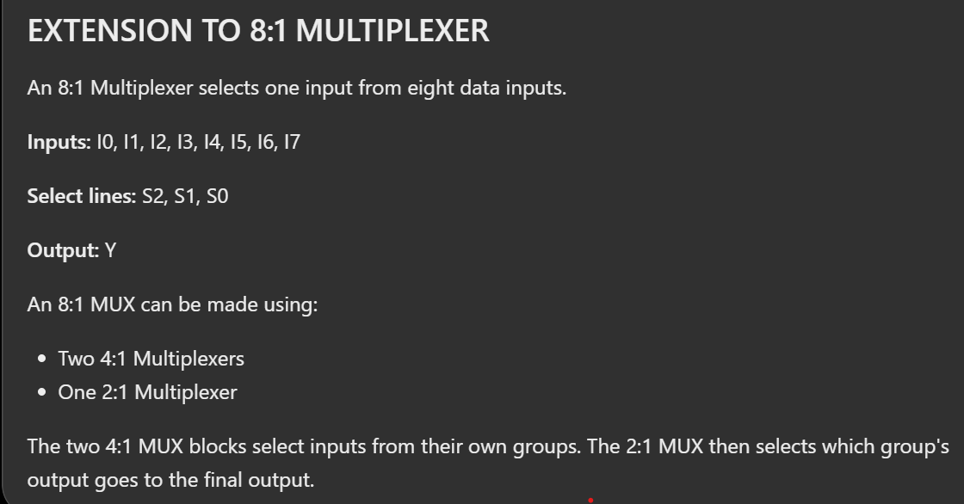

Slide 6
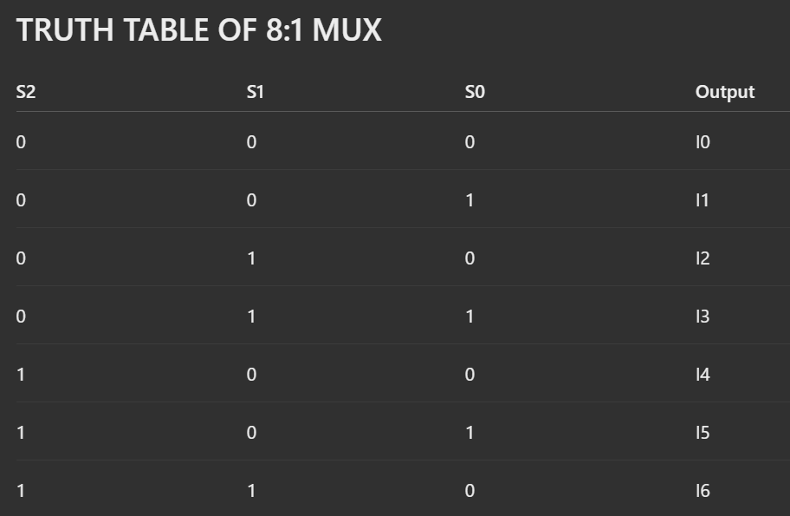
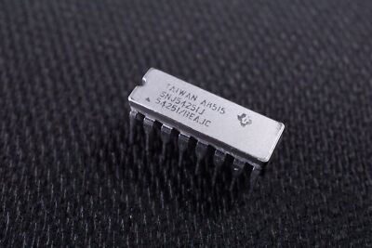
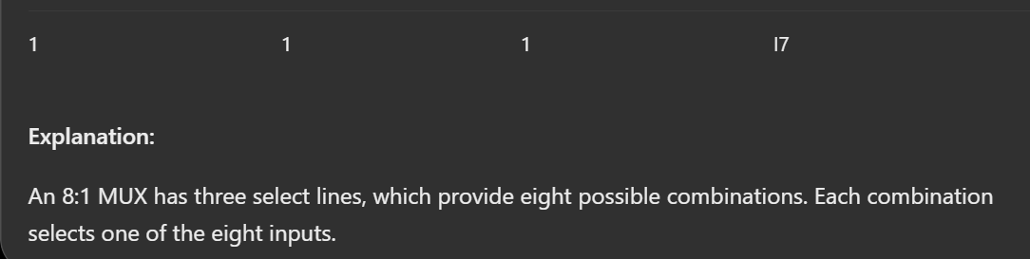

Slide 7
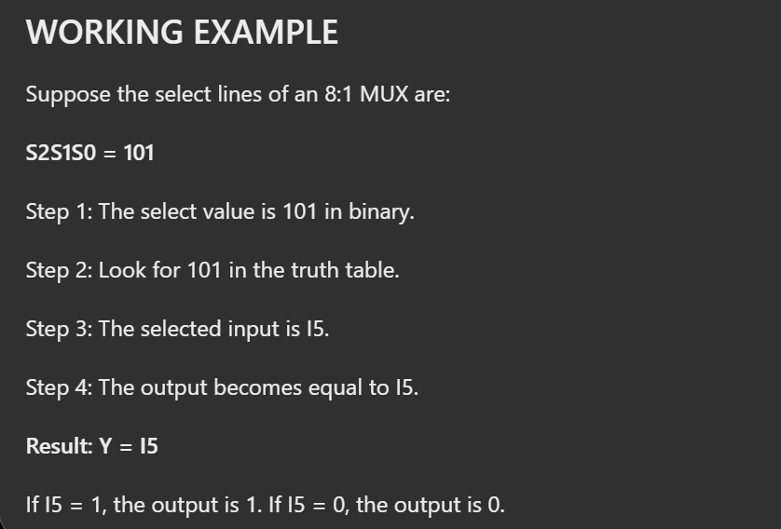
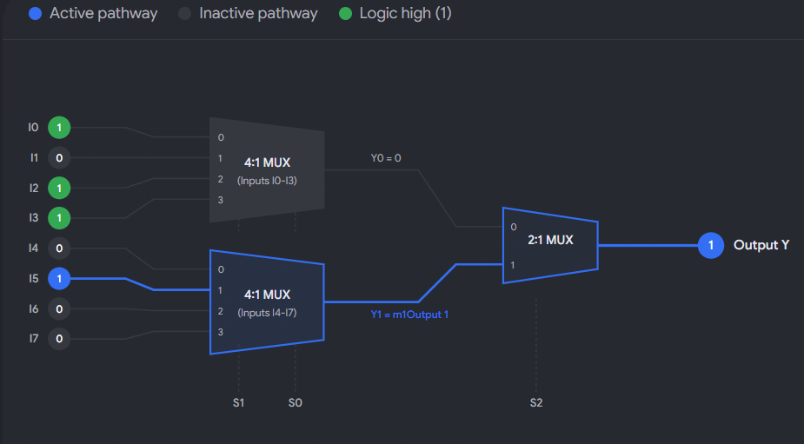

Slide 8
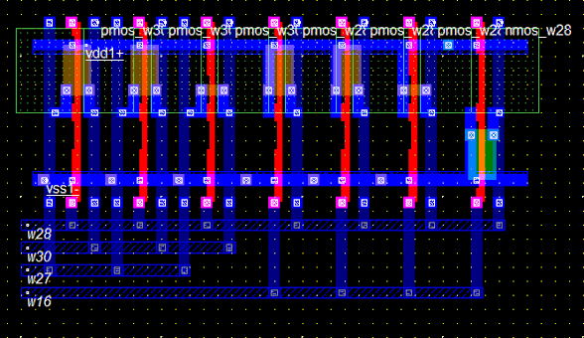
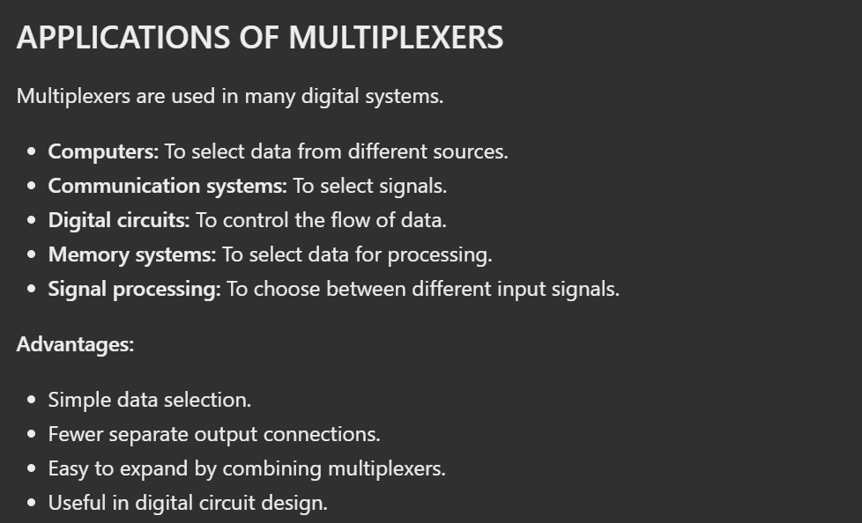

Slide 9
